Slide 1
与时俱进，开放共赢
Avaya Contact Center Roadmap
May 2014

Slide 2



客户的需求在变
基于语音的
独立
呼叫中心
分布式 多渠道 联络中心
大数据，云部署，全媒体
Notes:
2
Now let’s take a look at how customer service environments are changing.
Customer Service over the last decade has centered on voice-based call and multichannel contact centers- mostly reacting and responding to customer inquiries. The next phase, an evolution that is already underway, is context-based and enterprise wide customer engagement.
The value of any interaction is always defined by its context. What do we mean by that? There is an immense amount of knowledge about the customer for a company to tap into - information in databases and processes, customer profiles, knowing how EACH customer wants to interact, past transactions, and current intent- that all can be used to better engage, and satisfy the end customer.
IF you understand context, you can enable and deliver a differentiated, personalized, proactive interaction with end customs. What‘s the benefit?
o Improved customer satisfaction (retention/loyalty)
o Incremental revenue (up-sell/cross-sell)
o Improved Productivity and Reduced Costs

Slide 3
Avaya 在改变
Voice HW Vendor
Collaboration SW & Service Vendor
Closed Infrastructure
Open Infrastructure + Middle Ware
Capex Selling
Cloud Service

Slide 4

Avaya的成功离不开Aura CM生态环境中的各位合作伙伴
CTI
Agent Desktop
Reporting
IVR
ACD + TSAPI
SERVICE
Project Management
Customers
Partner
DEVELOMENT
Aura CM
Notes:
4

Slide 5

今天, 我们有了第二个优质应用平台
AWARE CUSTOMER
EXPERIENCE
ANY MEDIA
Customer Sees
One Company
VOICE
VIDEO
EXPERIENCE
PORTAL
PERFORMANCE AND ANALYTICS
Organization Sees
One Customer
Notes:
Experience portal is a cornerstone for solutions available today to get to context-aware customer experience – will only get better as need solutions come into play…
Enable our existing customers deliver a great omnichannel customer experience, help them unify disconnected customer experiences across mobile, web, contact center channels, make it easier to gather and act on context across interactions in real-time – and achieve a more ideal context-aware customer experience where the company sees one customer and customer sees one company.
Provide them that evolutionary path fully leverages what they have today – CC Elite, AACC – inbound outbound any media self-service
Squeeze out some of the complexity – backend application development, management consistent with the way companies want to build and manage applications and services today – giving them the control they need to address business needs more holistically, more quickly
Delivering great interactions across mobile, SMS, email, contact center – we’d spoken last year and continue to focus on how technologies that enable great interactions help companies drive real business outcomes and results – CSAT, NPS, FCR, Customer Effort – as well as topline and bottomline goals.

Slide 6


Experience Portal…
不仅是IVR
IVR
Customers
Enterprise
Notes:
© 2009 Avaya Inc. All rights reserved.
6
© 2009 Avaya Inc. All rights reserved.
6
We have been more expansive having redefined Voice Portal as Experience Portal quite awhile – started to bring together web, mobile, contact center touch points, not just a voice application platform but as a platform for any media self-service, unify self-service and call routing when we integrated ICR and added advanced outbound capabilities like call detection, multiparty conferencing and more…also an architecture thrust –
A key enabler is being able to deliver solutions that integrate tightly with existing web services and applications – that bring together the various elements – mobile, web, and contact center – to ease visibility into customer interaction history, customer experience, satisfaction – and easily share this information across services, applications, and teams

Slide 7
更是多媒体交互平台
Voice
路由
多媒体
Speech
高级呼叫等待策略
Contextual
联络数据
Email/SMS 主动服务
视频
自助服务
回呼助理
智能呼叫路由
移动终端
社会化
媒体
统计
客户
企业
Avaya Aura®
Experience Portal
Orchestration Designer
Notes:
© 2009 Avaya Inc. All rights reserved.
7
© 2009 Avaya Inc. All rights reserved.
7
Apps
Customer Connections Mobile iPhone/Android apps tied to contact center
One Touch Video
Web-based voice and video response, video kiosk, 3G
Proactive Outreach Manager
Automated outbound speech, email, SMS campaigns and alerts
Intelligent Customer Routing
Dynamic self service and load balancing
Callback Assist
Immediate/scheduled call back over web, mobile, speech
Speech Dial
Individual or group auto attendant

Slide 8









Customer Successes – 不仅有交行
NDA
Mid-sized Enterprise
Large Enterprise
Improve citizen response, debt recovery, reduce collection costs using SMS and email with escalation to outbound agents
400K+ SMS texts sent daily to inform customers of layaway and pickup status
Streamline claims processing and customer communications with automated SMS and email outreach
Optimize customer segmentation and localize resource assignment with Intelligent Customer Routing
SMS & email enable SmartGridCity program & outage alerts. Callback & Intelligent Customer Routing optimize response, reduce outsourcing cost
World’s Largest Contact Center running on Intelligent Customer Routing, Callback, Proactive Outreach, ContextStore
Cloud
Replacing aged Cisco ICM with Experience Portal to fix disconnected service experience
Improve flexibility and time to market with private cloud hosted self service with Experience Portal. Competition: Genesys, Syntellect, Intervoice
Notes:
Last time we talked about dual path, simplicity – put red boxes across top to show what we were going to focus on.... “a solution for every customer” – pull in 4 arrows mini to this slide
Expanding business model (AOS and Cloud) – shows diff way of selling
UHG
Avaya received $1.6M in PO's on 5/31, booked on 6/5, for the first phase of the UHG Next Generation Contact Center which includes AEP, ICR, Context Store & CM Upgrades. This was a significant achievement for the team as it shows UHG that Avaya can bring a next generation set of solutions that enables them to grow to 50K+ concurrent agents while migrating away from their Cisco ICM environment. This is a significant change in direction from where Avaya was in this account a year ago and a strategic win. There is still a lot of work for this team as this win will be deployed in a pre-production environment where UHG will be proving out the solutions rolling them out to a small subset of their agent population. Success in this will drive $10M in follow-on revenue in FY2014, continued revenue growth in FY2015 and solidify our position as the vendor of choice for their Next Generation Contact Center.
Fidelity National Information Services - FIS: - 13 million TCV over 84 months
FIS™ is the world’s largest global provider dedicated to banking and payments technologies. With a long history deeply rooted in the financial services sector, FIS serves more than 14,000 institutions in over 110 countries. Headquartered in Jacksonville, Fla., FIS employs more than 37,000 people worldwide and holds leadership positions in payment processing and banking solutions, providing software, services and outsourcing of the technology that drives financial institutions.
FIS is ranked 434 on the Fortune 500 and is a member of Standard & Poor’s 500® Index. FIS has also been named the No. 1 overall financial technology provider in the annual FinTech 100 rankings three times running - 2011, 2012 and 2013. Despite these achievements, we never lose sight of the fact that it’s our clients that make us successful. That’s why FIS’ commitment to operational excellence and client satisfaction is at the forefront of our business strategies and top of mind with every decision we make.
Business challenge – had multiple aging and disparate IVR platforms creating a drain on operations costs as well as creating an inconsistent customer experience. They needed a solution provide them more flexibility and faster time to market
COS Private Cloud Solution
FIS had multiple IVR solutions supporting more than 10 lines of business internally and they were looking to reduce support and maintenance costs without a Capital outlay. FIS issued and RFP written specifically for a multi-tenant, Hosted solution to address their business issue by collapsing all the IVR’s into a scalable and flexible model that would allow FIS business units expand and contract as their business requirements changed over time. There was significant competition from Genesys, Syntellect, Intervoice and others
What was sold:
Private-Cloud solution hosted in Avaya datacenters
2000 IVR ports with projected expansion to 5000 ports over term of the contract
84 month term
Avaya responded with both a Capex (Capital expenditure) model and an AOS Utility model, both of which did not meet the requirements of the RFP. Avaya was able to present our RFP response solution where we were able to demonstrate the virtues of the AOS utility model solution (on-net calls, security features, customizable solution and growth flexibility). Through many iterations (and months) the committed deal value is over $13M over 84 months for a 2000 port IVR solution with expansion of the solution to a projected 5000 IVR port steady state during the term.

Slide 9
明天，我们怎样与时俱进
WebRTC
  Connecting All Interactions as a Seamless Experience
COLLABORATION DESIGNER
AWARE CUSTOMER
EXPERIENCE
ANY MEDIA
REAL-TIME SPEECH
CONTEXT STORE
Customer Sees
One Company
VOICE
VIDEO
EXPERIENCE
PORTAL
WORK ASSIGNMENT
COLLABORATION ENVIRONMENT
UNIFIED DESKTOP
REPORTING AND ANALYTICS
PERFORMANCE AND ANALYTICS
Organization Sees
One Customer
Notes:
CE NAMES MENTIONED UNDER NDA - list of customers working with around CE – make it real
Build – Today – richness of the solutions and capabilities of platform today. Tomorrow – and these other things make it that much more impressive and more differentiated services. We continue to deliver solutions that enable our customers large and small evolve…and evolve even faster.
“Collaboration Environment” - A scalable unified middleware platform for execution and management of diverse, dynamically deployable services and applications
We have been taking – someone like Contax – seen this interest growing – snap-in easily – working with them in the development of the solution – help drive the development of the -
Snap-ins create some sense of credibility – great way to jump start application capabilities in areas that we know customers are interested in – for example context store – really provide that omnichannel experience – but its contextually relevant – something can start to approach with ICR today –
Real-time Speech
Context Store
Enterprise Work Assignment
WebRTC
For those attending -those Innovations Lounge – 4 of them will be shown – kick the tires and learn a little bit more….
Context Store - Business process - web/mobile - link the two worlds by making it easy to pass information. Understanding that cultural/business as much as a technology.
Core ideas are persisent experience and across enterprise resources is core
Time to re-imagine customer experience and reinvent the contact center - contextually aware, persistent experience
Real-time 1:1 personalization can’t be fully met with traditional contact center approach – requires re-imagining customer experience approach, model, and architecture. For more than 20 years, Avaya has been a leader partnering with companies globally to tackle their greatest contact center and communications challenges. We are ready again now to help solve these challenges both today and for a better future

Slide 10
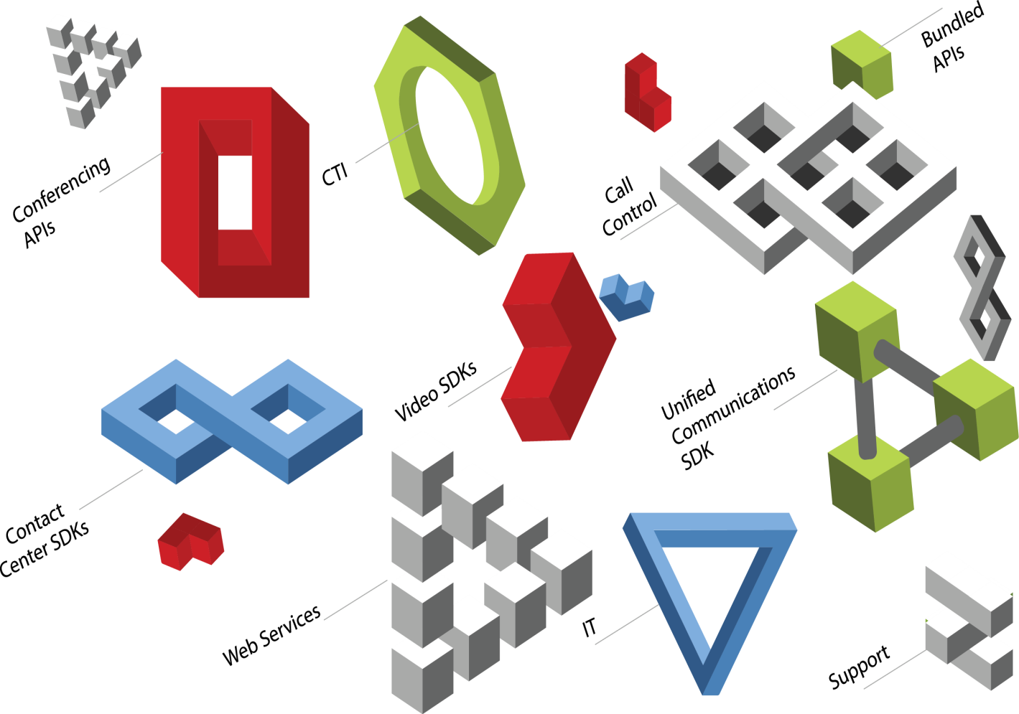
一套SDK包含如下所有功能
Partner可以
  将协作功能集成到业务应用中（CEBP)
  开发高度定制化应用
  开发公用协作功能模块提供给其他应用

Slide 11

CE: SDK+部署平台
3rd Party ISV Developed Application
Email
SMS
Scopia
Customer Developed Application
IVR
Collaboration Environment
Web
Customer
Mobile
Work Assignment
R-T
Speech
Web RTC
Social
Avaya App Module
Avaya Applications
无忧应用: 平台提供
  高可靠性
  可扩展性
  安全性
  虚拟化支持
  管理功能
Employee
Customer
Service

Slide 12
四大类CE应用 in CE 2.0
GA
Oct 7, 2013
Snap-in Applications Delivered on the Collaboration Bus:
Exposes and enables the re-use of capabilities and events by other applications
Applications
Leveraging
Multi-Channel Broadcast:
Broadcast pre-recorded audio, email and SMS messages to local or remote destinations
Call Intercept:
Enables the intercept of calls, and applies business logic or manipulates the call session
Applications
Doing Dynamic Team Formation:
Coordinates teams on Scopia audio/video conference using SMS and/or email alerts

Slide 13



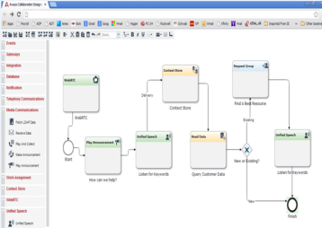
CC - Focused CE 3.0（GA target 3Q CY14)
Web RTC: Multi Media Web Client
Real Time Speech: Voice Analytics
Work Assignment: Customer / Agent 1:1 mapping
Collaboration Designer: Development tools of application integraiton

Slide 14

Avaya Collaboration Designer Snap-in
Internal only; not for use with customers
Avaya Collaboration Designer 3.0
4Q CY14
(Planned)
Enables non-developers to integrate CE and Snap-in functionality on a single canvas
Graphical User Interface Allows Coding without Java knowledge
Quickly deploy high value, multi-channel use cases
Long Running Transactions allow for Workflows to be stored in Memory for days, weeks, or months
Empowers Enterprise Resources to Easily Produce Journey Maps

Slide 15

Avaya WebRTC Snap-in
Internal only; not for use with customers
Avaya WebRTC 3.0
4Q CY14
(Planned)
Allows consumers to ‘click to call’ from any supported browser and connect to an agent seamlessly
No browser plugins are needed
Easily integrates with Context Store, providing relevant contextual data to agents
Audio stream integrates with Real-Time Speech which enables verbal menus as well as an ability to monitor agent script compliance
Real-Time Browser Communications Enabling Click to
Call Functionality

Slide 16
Context Store Snap-in Roadmap
Internal only; not for use with customers
Context Store 3.0
3Q CY14
(Planned)
Context Store 3.x
(Concept)
Context Store 4.0
(Concept)
Track and Share Customer Context | CRM Integration | Auto Track Context
Deliver consistent and seamless customer experience across all touch points. CE Snap-ins can leverage low latency in-memory data cache on CE using native access for sharing contextual information Delivered as a snap-in on CE to deliver rapid business value at a low cost. | Provides ability to track and share 360 view of the customer. Enables business activity monitoring Geo-redundancy | Auto-creation of context objects Cross Channel tracking and analytics
Low Latency, scalable and resilient in-memory data cache Secure RESTful API for external interface and native Java API for CE snap-ins CE 3.0 Workflow integration via native workflow tasks Experience Portal integration via pluggable data connector Simple URL based access for Screen Pop applications Data export for persistence and analytics | Provide connectors to CRM system Rules based auto-population of CRM and other data in Context Store Integration to Unified Collaboration Model to feed business metrics Integration to Avaya Experience Portal for auto-creation of context objects upon call arrivals Real-time event stream of context changes Improved capacity and performance Geo Redundancy Unified Desktop Integration | Auto-create system level objects and data in the context store with integration to Avaya Ecosystem
THEME
BUSINESS VALUE
TOP RELEASE FEATURES
Notes:
EM is the “one ring that binds them all” that brings together both third party ACDs, but Elite and AACC “dual stack” customer configurations to combine them in a single enterprise. Customers can easily evolve from either the “AACC Stack” or the “Elite” stack and overlay the 1:1 agent mapping of Experience Manager and get the advantages of the ICR component included in EM.
Since Experience Manager has ICR as one of its components, it builds on any existing ICR implementation adding dynamic routing, and single enterprise-wide queuing to the AACC and Elite base. The natural progression is AACC or Elite or both, then add ICR, then add ICR Dynamic Routing, and then adding Experience Manager in a smooth, seamless upgrade path.
Since EM brings 1:1 workflow agent mapping to build on the now ubiquitous skills based routing, this allows unique never-before done mapping of incoming contacts to agents. Using enterprise rules designed using Orchestration Designer and the ACCCM management tools, EM performs the workflow mapping of incoming work to the right agent using attributes of both. Attributes of the incoming work are kept in the EM “context store” and then compared with the attributes of the agent with a blistering 1.8M comparisons a second using the EM workflow engine. In addition, EM uses the same technologies used by the financial industry to provide a geo-redundant data-grid where servers can be added to the grid at any location to improve redundancy OR performance, OR both!
One great example to highlight the EM 1:1 mapping is the ability to bring subsequent contacts from the same person to be handled by the same agent, or allow the customer to leave a message and get contacted back by the same agent if a specified time period expires before the agent is available.
One other example that highlights EM’s capabilities is the ability to match gender, age, location of the contacts with the agents (they may wait a little longer for this) so the customer care is increased! Female agents sell to female customers better? Then set a rule in EM to make it so! Need a Houston Agent to handle calls from Houston? Just set up an EM rule to make it so.
In Summary, Experience Manager (EM) leverages the value of Avaya’s existing contact center CC Elite, AACC, and AIC by providing an overlay network routing via ICR to bind and coordinate the these core contact center products to look and function as one. In addition, EM revolutionizes the contact center ACD “queuing” environment by introducing a one-one mapping of incoming contact “work” and the best available agent. A major breakthrough in insuring customer satisfaction, work assignment allows EM to assign an incoming contact request to the agent best able to handle the interaction, but by following specific rules outlined by the contact center administrator. No longer does a contact request get assigned to an agent based on just queue time and agent skill; the business rules for the contact center apply and force the interactions to follow a pre-defined strategy! CC administrators can now design contact centers to do cool things like match the same agent to a customer for subsequent contacts even if they wait a bit longer! Or match up gender, age, location, and content between agents and incoming contacts for an optimal “match” even if contacts wait a bit longer... In short, contact centers can be managed and run to follow rules that are more than just simple queueing!
More Detail: EM also adds dynamic routing, and a persistent context store to what is out there in the market today:
Dynamic Routing - EM customers enjoy a dramatic lower cost of ownership because multiple locations served by multiple CC Elite and AACC instances can be managed and run as a single, worldwide contact center with centralized, universal agent assignment strategies (including single queuing)
Context Store - Contact center designers enjoy both a lower cost of ownership and a much improved development interval because all information for a customer is stored in the EM cache. EM is easily configured to gather and store information from contact center databases and back office repositories.

Slide 17
CC 产品定位
细分市场 | 商业市场，中小容量 （简单应用，快捷部署和管理） 5-30坐席 | 行业用户，中等容量 （新型企业，多媒体要求） 30-400用户 | 大型企业、政府、金融，大容量 （PS/FSI，多点，集中路由） 400-5000坐席
整体产品定位及 对应方案 | EMC平台：提供高性价比Avaya一体化方案 | Elite-M促销包：主推全套方案 主推Avaya IC、EP平台 更低的成本，同Genesys竞争 | 推动Avaya全套方案 推动ICR概念，影响客户未来计划 推动EP方案，引导Edify更新方向
CTI | EMC | IC | IC
报表 | EMC内置报表 | CMS 虚机版（Elite-M促销包中) 多媒体：增加Avaya统一报表系统 | CMS 多媒体：增加Avaya统一报表系统
自助服务 | 采用内置语音引导 高要求客户推荐 EP | EP | 包装AEP方案和更新计划 引导客户Edify更新计划
座席监控（录音/质检/排班） | 不推荐 | ACR（Elite-M促销包中) 高端客户推荐更多功能模块(QM) | ACR + QM 高端客户推荐更多功能模块(WFM/SA)
外呼 | TSAPI 预览外呼 | TSAPI 预览外呼 高端客户推荐 POM | POM
SIP CC | 不推荐 | 不推荐 | 包装ICR概念，引导客户需求
本地化集成 | Avaya 多媒体呼叫中心平台；Avaya统一报表系统（Solution Team，5月推出第一版） 培训和推广

